Slide 1
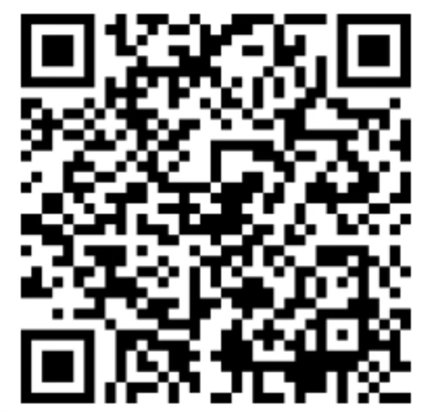

Are Knowledge and Reference in Multilingual Language Models Cross-Lingually Consistent?
Xi Ai*, Mahardika Krisna Ihsani*, Min-Yen Kan
Language Diversity and Knowledge Consistency
Conclusion
A salient aspect of humanity is that, while people may speak different languages, they can share common references and knowledge. We are thus interested in analyzing, evaluating, and interpreting cross-lingual consistency for factual knowledge. In this work, we measure consistency evolution by quantifying the distribution difference between two code-mixed, coreferential statements for each layer’s output.
Multilingual models uncovers a consistency bottleneck whereby the consistency does not grow monotonically on each layer.
Key Factors
model architectures
training strategies
deep semantic alignments
Promising directions
test-time calibration
training with cross-lingual alignment objectives
code-switching training
Not necessary and sufficient conditions
cross-lingual representations
shared scripts
parallel samples
Model: 1) Encoder models (xlm-r from 0.3B to 10B), 2) Encoder-Decoder models (mT0 from 0.6B to 3.7B, mT5 from 0.6B to 3.7B) , and 3) Decoder models (Llama3-instruct 1B \& 8B)
Dataset: mLAMA provides parallel triples (object, predicate, subject) in 53 languages written in cloze, completion task format (e.g., “Paris is the capital of ”) to query knowledge in zero-shot settings.
Consistency Metrics: 1) Logit Lens (multiply representations by embeddings for distributions over the vocabulary): RankC without output domain (Weighted Top-5 distribution) and Accuracy (Top-1) and 2) CKA similarity
Findings
Findings
Method: we compare a base model with a vocabulary-expended model (VP-x) to isolate the vocabulary factor or the shared-script factor.
Shared language scripts contribute to cross-lingual consistency, especially for encoder and decoder models, but it is not a necessary condition to achieve it.
Method: we compute the consistency metrics for each layer’s representation and organize the results from the final output into 6 bins.
Consistency bottlenecks and issues tied to language characteristics, scripts, and training biases through layer-wise analyses and interpretability approaches, which potentially prevent cross-lingual consistency improvements and gains from scaling.
Findings
Findings
Method: we take the activated neurons (IG2 scores) into account.
Consistency moderately correlates with sharing feed-forward neurons at all the layers statistically.
Method: we patch English-biased activation to other languages.
There is a partial causality from adding language biases (of high-resource languages) to improving cross-lingual knowledge consistency. Directly adding bias via representation patching could be a potential method to calibrate consistency in the test time.
Findings
Method: we examine tuned models that show promising performance in multilinguality.
Cross-lingual supervision can alleviate the consistency bottleneck to enhance alignments between coreferential entities, which can be achieved by training with an explicit alignment objective or a code-switching objective. On the other hand, parallel samples providing cross-lingual generalization supervision offer limited gains to consistency.

